Slide 1
Data Analytics and Visualization: Final In-class Presentation
Project Title: Unlocking Game Secrets: Unveiling the Dynamics of Sports Through Data Analytics and Visualizations
Presented By:
Name: Daphine Nalule
Student Number: 2300723225
Registration Number: 2023/HD05/23225U
Name: Elaijah Edekebon
Student Number: 2300704665
Registration Number: 2023/HD05/04665U
Notes:
Photo by LYCS Architecture on Unsplash

Slide 2
Presentation Outline
Introduction/Motivation of the project
Related work
Problem Statement
Research Questions
Research Contributions
Methodology
Visualizations
Limitations
Conclusions

Slide 3
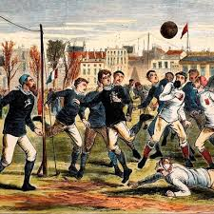
Introduction
The world of professional sports is constantly changing, especially football.
The first-ever international match was played between England and Scotland in 1872.
The match ended in a 0 – 0 draw.
152 years later, football has grown from its roots in Europe to reach all around the world

Slide 4
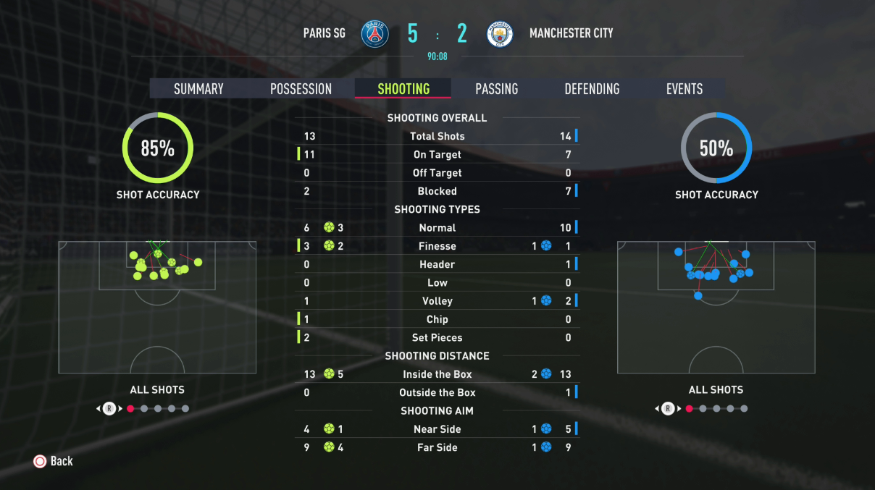
Problem Statement
While some media outlets and professional teams have harnessed the power of data, the broader adoption remains limited by knowledge gaps and accessibility challenges.

Slide 5
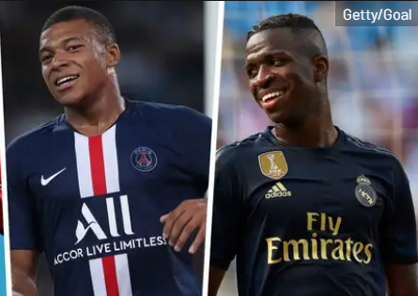
Research Questions
What metrics can best forecast the future potential of young athletes?
How can a team’s playing strategy be optimized based on the analysis of player performance data?
How does a player’s performance change throughout a season or their career?

Slide 6

Research Contributions
Significance
Enhance understanding of the critical factors that contribute to player and team performance in football.
Provide valuable insights for scouts, coaches, and team managers in player assessment and recruitment.
Application
Decision Support for Coaches and Teams.
Fan Engagement and Interaction.
Game Analysis and Commentary

Slide 7

Related work
This project is inspired by the growing field of sports analytics
We drew inspiration from studies such as:
Moneyball: The Art of Winning an Unfair Game by Michael Lewis (2003)
The Hidden Game of Football: A football handbook by Carroll, B., Palmer, P., & Thorn, J. (2023)
A systematic literature review on sports analytics by Chen et al. (2018)

Slide 8

Methodology
Data Acquisition:
Kaggle’s FIFA 20 Dataset
Statistical Analysis:
Multivariate Analysis
Clustering
Geographical Analysis
Visualization:
Interactive Scatter Plots
Heatmaps
Reg plots
Radar charts
Plotly charts

Slide 9
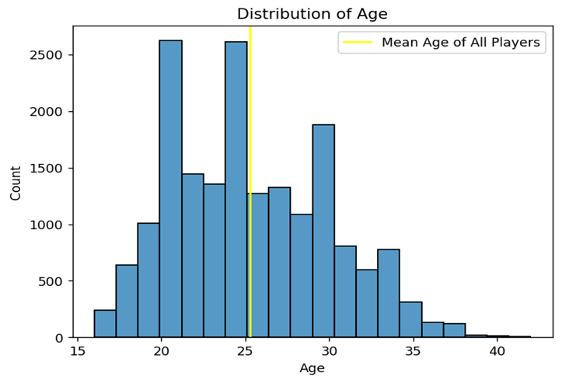
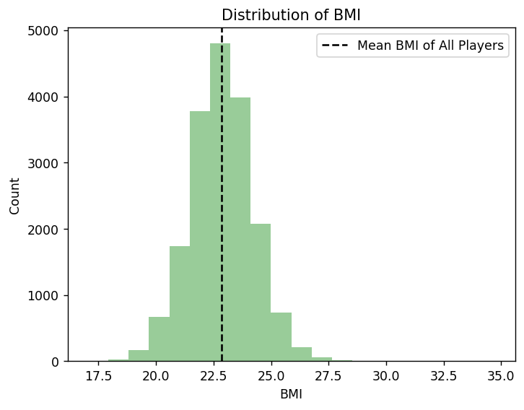



Results Highlights
Body Mass distribution
Distribution of age
Notes:
Photo by LYCS Architecture on Unsplash

Slide 10
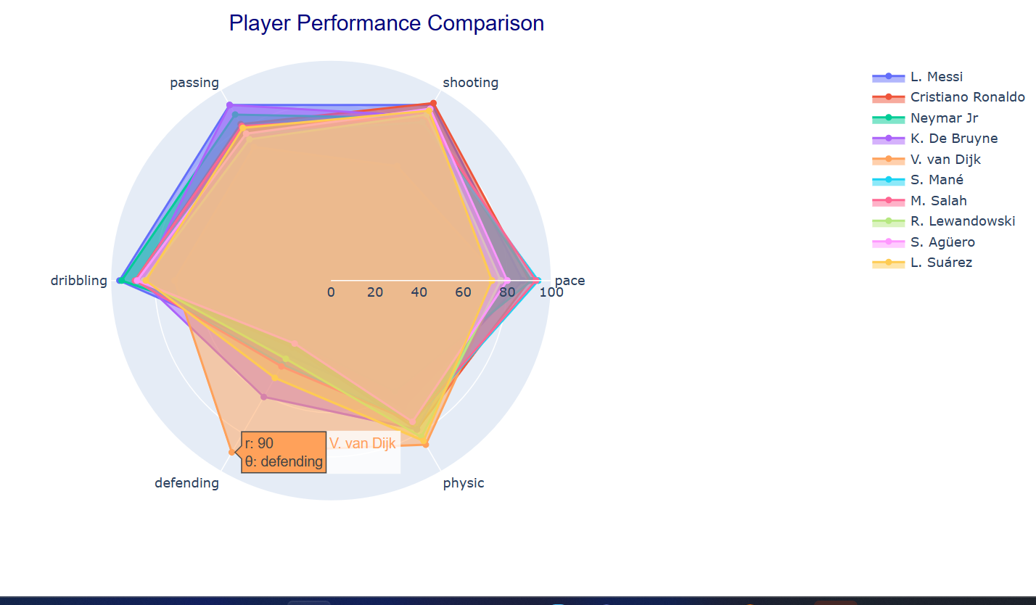
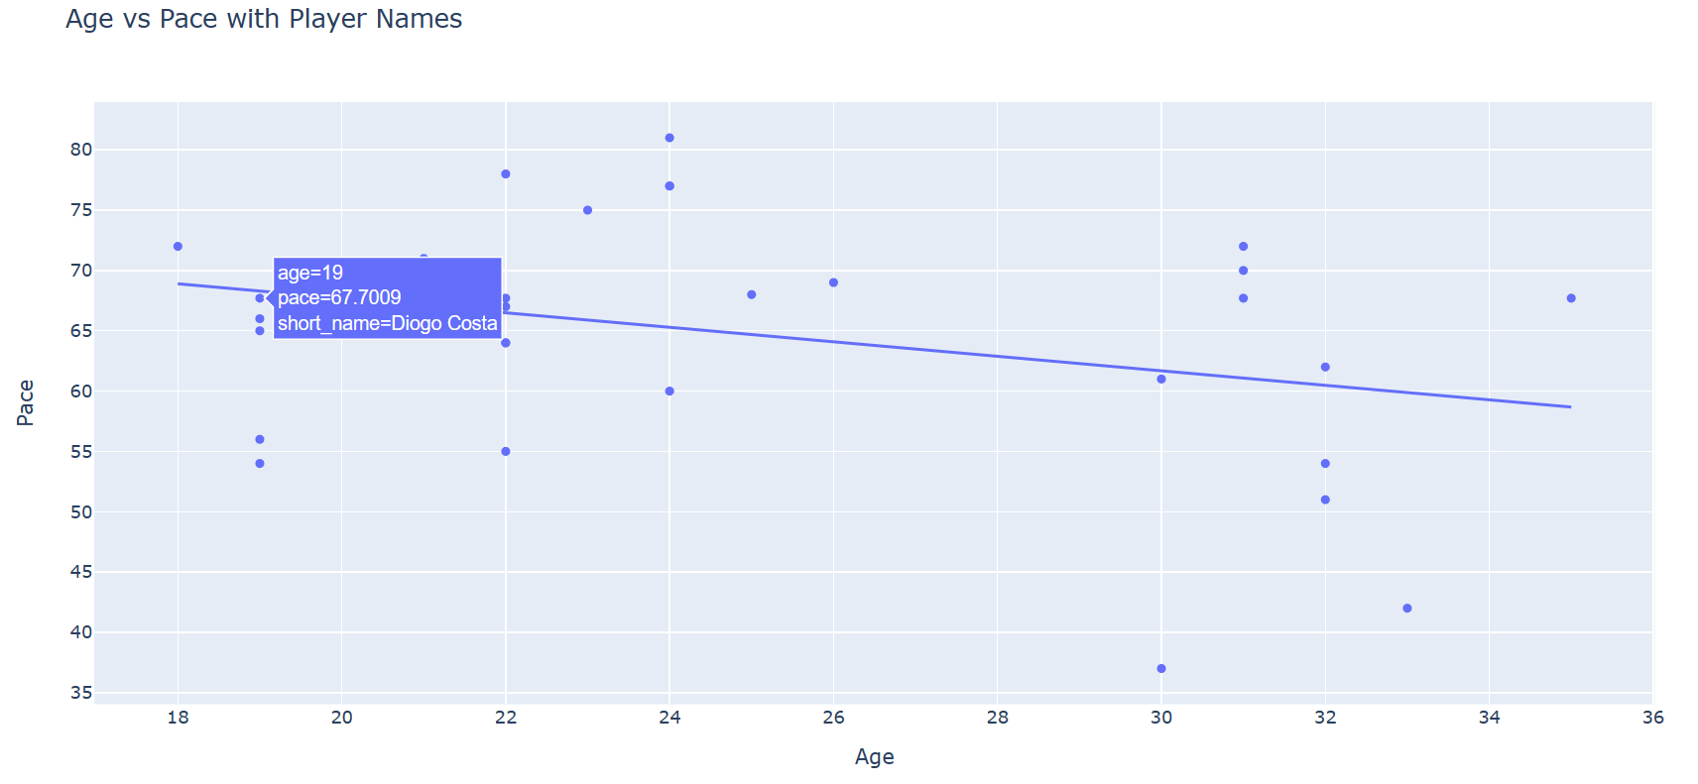
Results Highlights cont..
Player performance comparison
Age vs pace for players

Slide 11
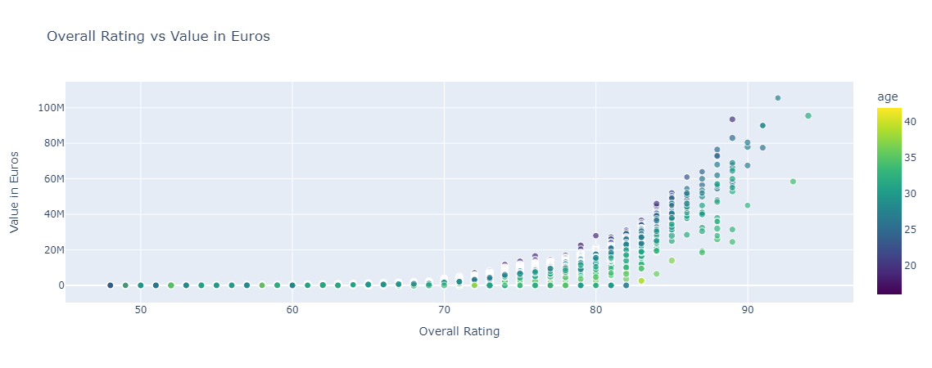
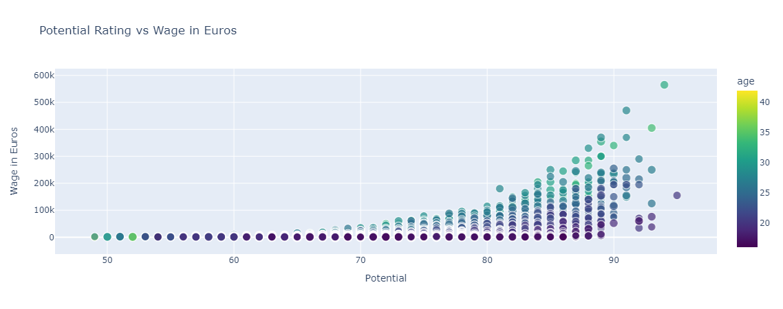
Results Highlights cont..
Player Overall Rating versus their market value
Projected Potential versus Financial Compensation
Notes:
Photo by LYCS Architecture on Unsplash

Slide 12
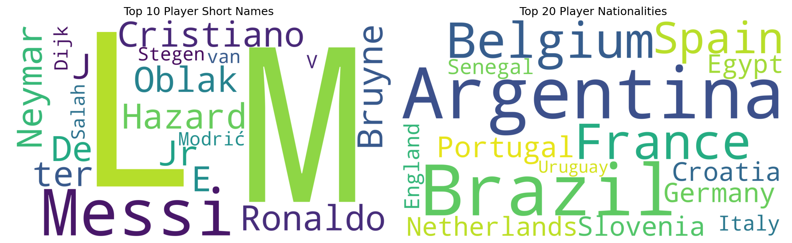
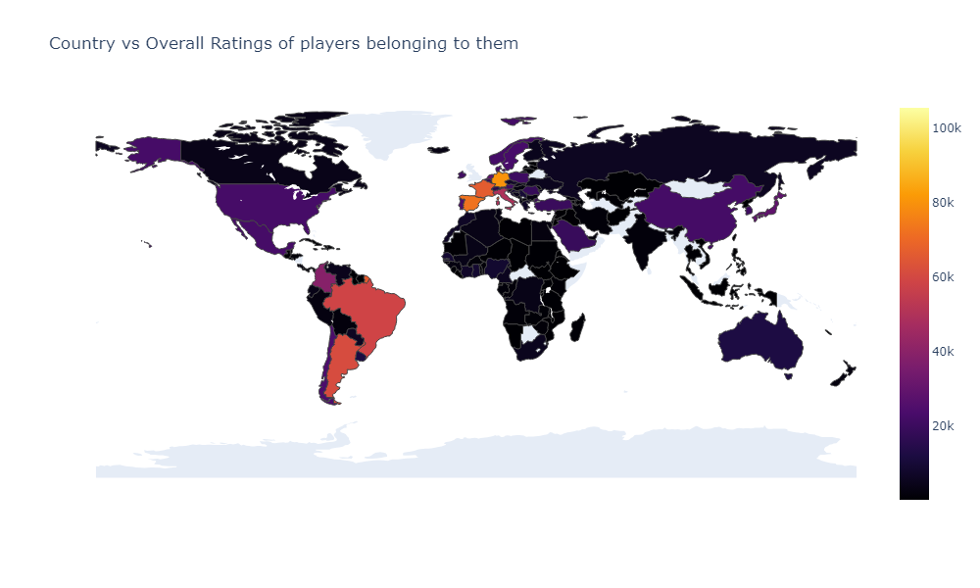
Results Highlights cont..
word cloud of top 20 players and nationality
Country and the count of players players belonging to them

Slide 13
Limitations
The potential drawback of the study is the potential presence of innate bias in the dataset, which may influence the applicability of the results

Slide 14
Conclusion
This project not only showcases the potential of sports analytics in enhancing our understanding of soccer but also serves as a blueprint for future research and applications in sports analytics.

Slide 15
Thank you

